Slide 1
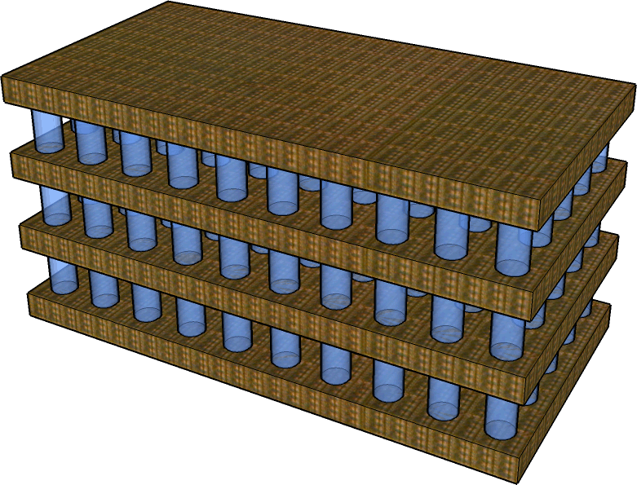
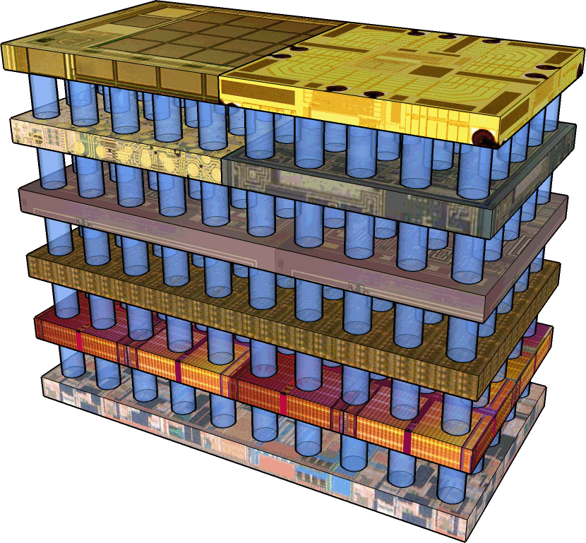
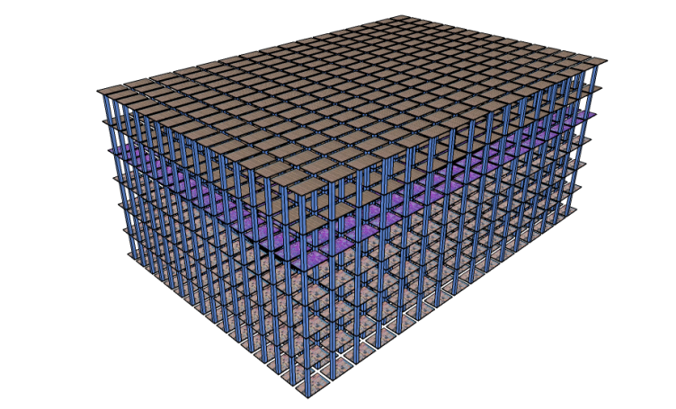
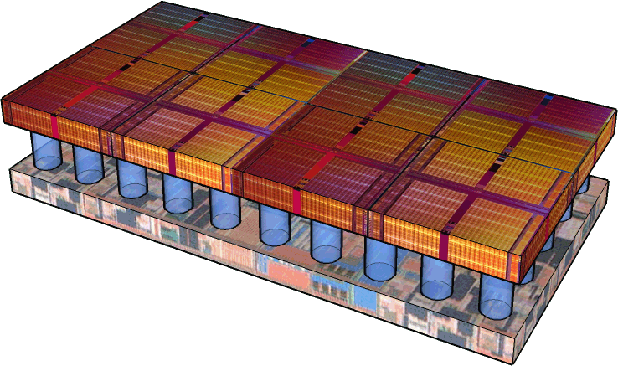
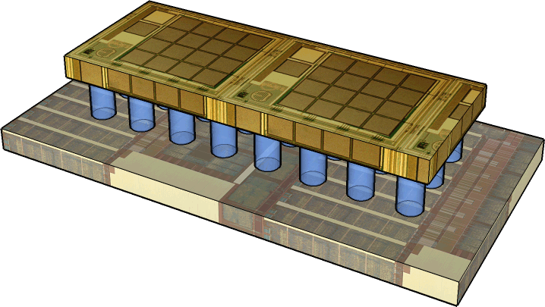
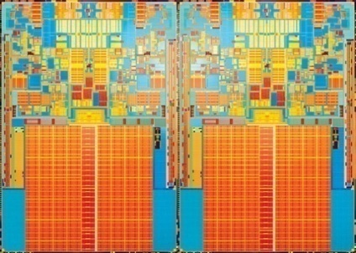
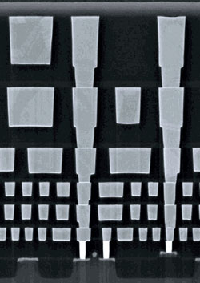
An Optimized 3D-Stacked Memory Architecture by Exploiting Excessive, High-Density TSV Bandwidth
Dong Hyuk Woo
Nak Hee Seong
Dean L. Lewis
Hsien-Hsin S. Lee
Electrical and Computer Engineering
Georgia Tech
The 16th International Symposium on High-Performance Computer Architecture

Slide 2
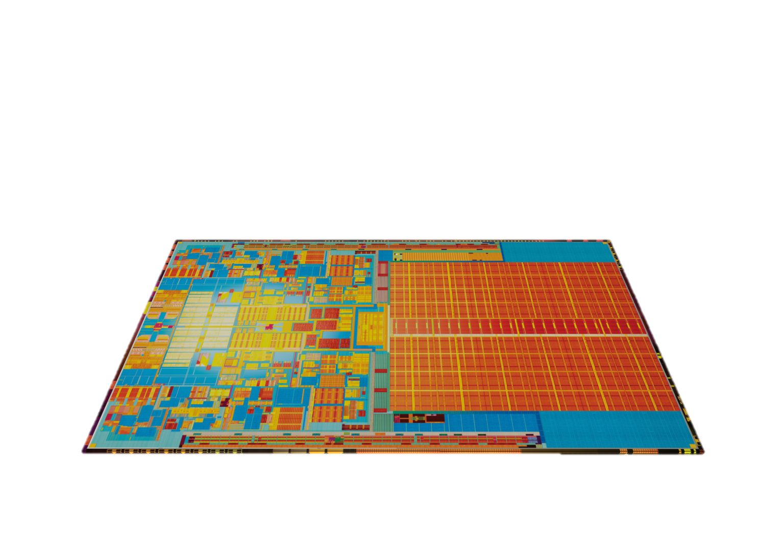
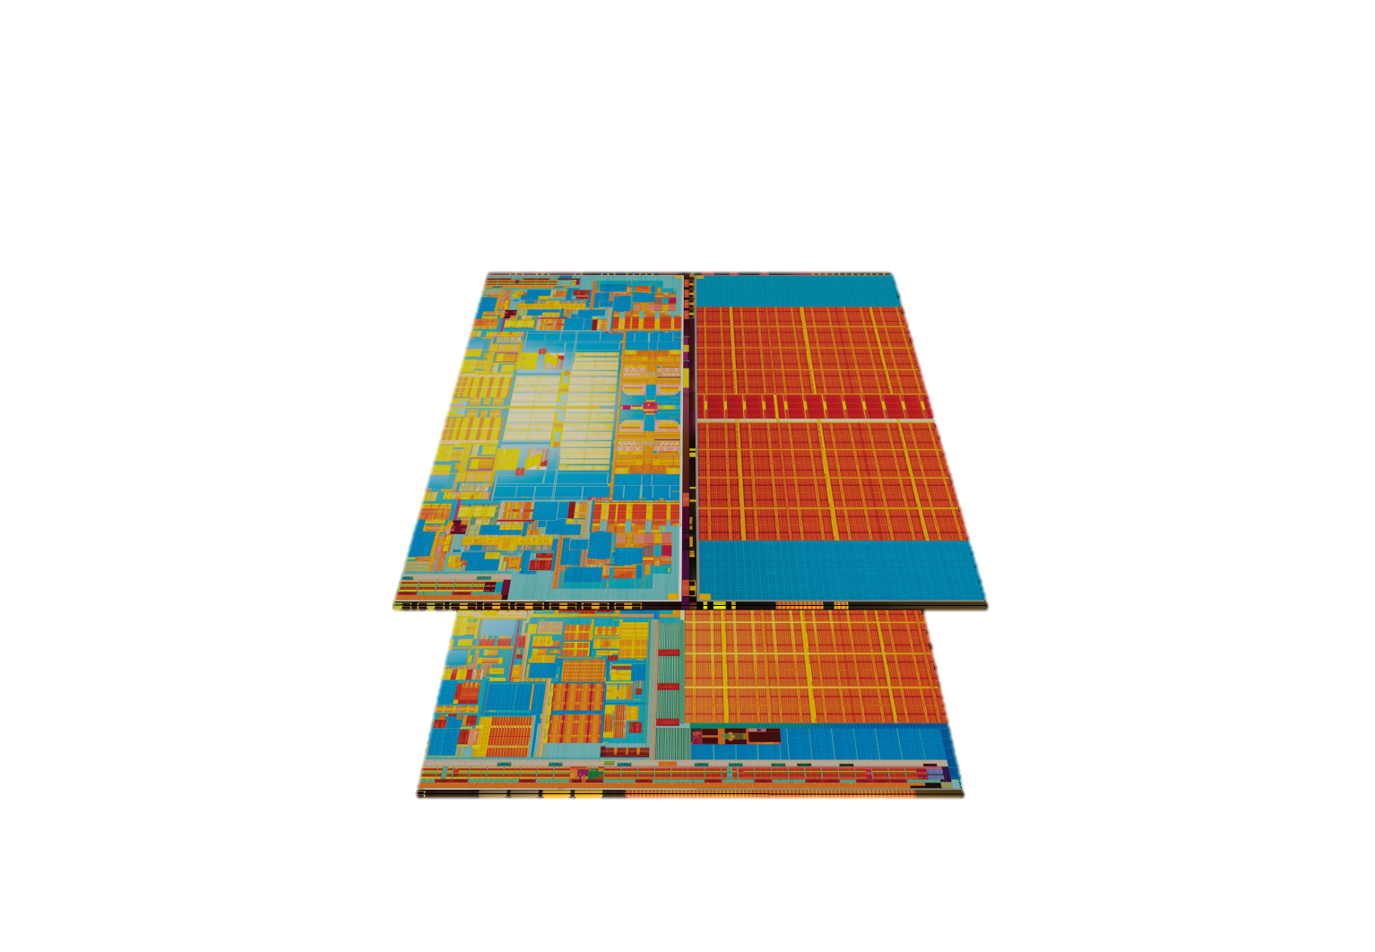
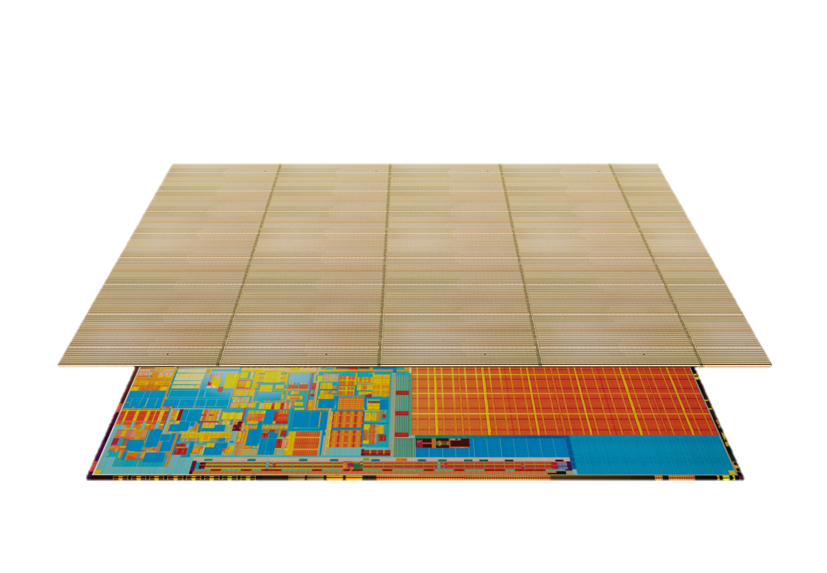
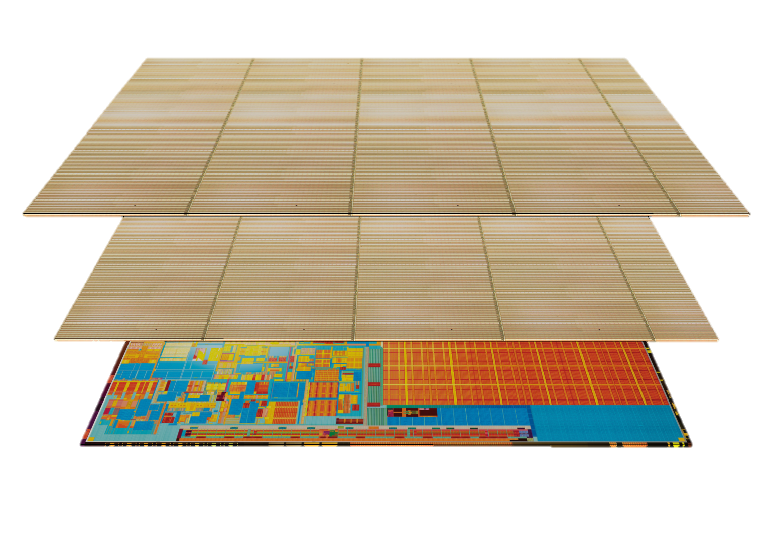
3D Integration
Multiple layers
Homogeneous tech.
Heterogeneous tech.

Slide 3
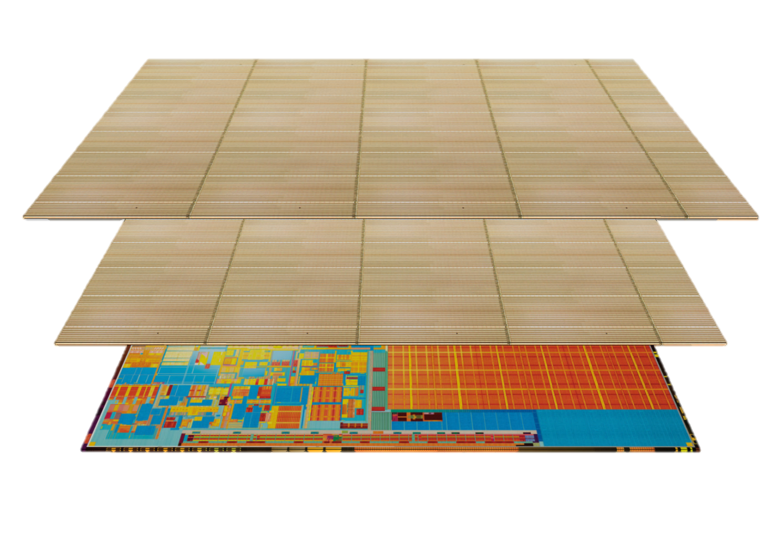
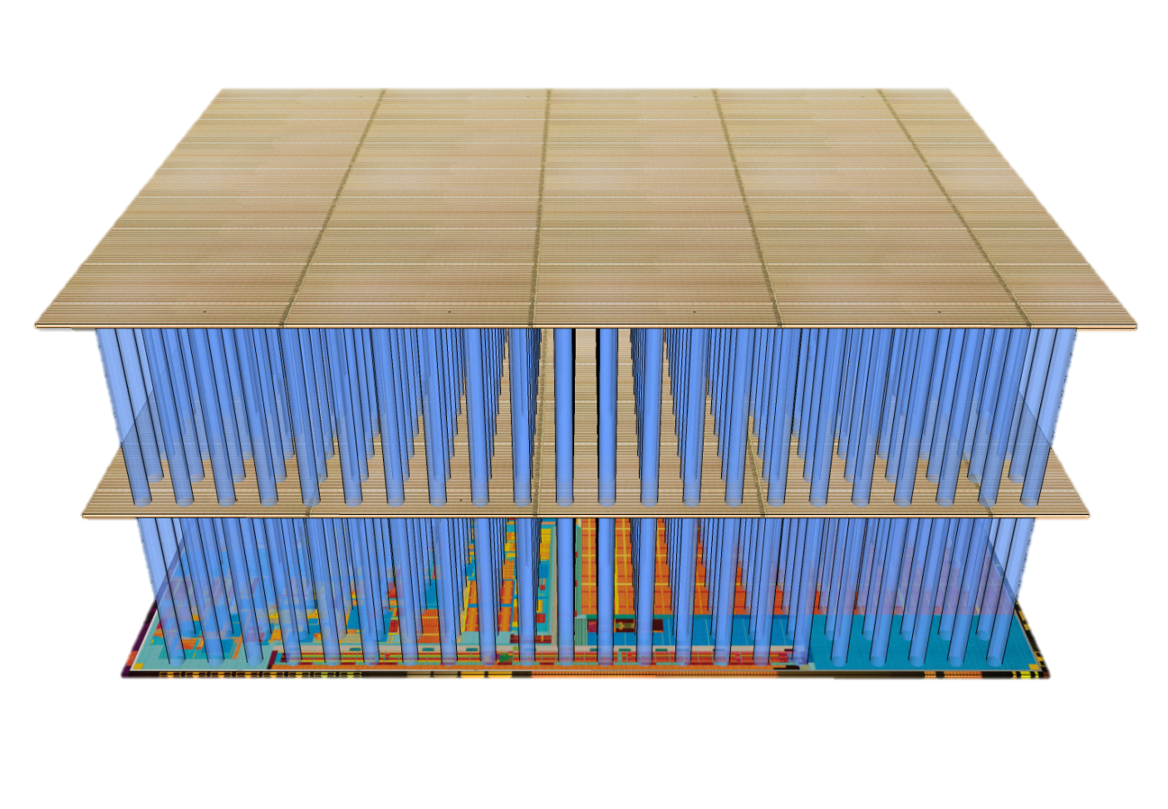
F2F Via and Through Silicon Via (TSV)
Can enlarge device area
Short, fast, and dense
Face-to-Back
(Scalable)
4um pitch in 2011 (ITRS 2007)
Face-to-Face
(limited to
2 die tiers)

Slide 4
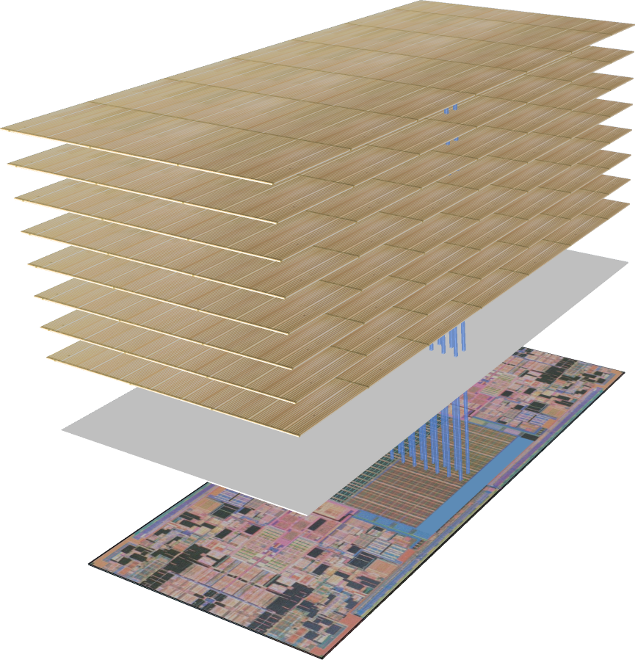
3D-Stacked DRAM
Higher
bus clock
Cache line-wide bus
Multiple channels
64B = 512 TSVs
per channel

Slide 5
Are we exploiting
its full potential?

Slide 6
Von Neumann Bottleneck-Aware Design
Cache
line size
Issue
width
Minimize
off-chip traffic!!!
Cache
capacity
Load
scheduling
Prefetching
Multi-threading

Slide 7
Revisiting Cache Line Size
Cache pollution
8MB
w/ 64B lines
256KB
w/ 4KB lines

Slide 8
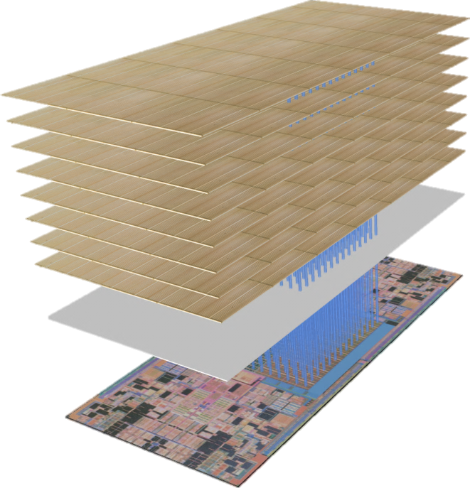
SMART-3D
3D memory interface design to allow page-level fetching
No more trailing-edge effect
Lots of TSVs
Overhead of pollution much eliminated
Practically no more contention

Slide 9
Issues of a Naïve Cache Design
Look up a 4KB line in an 8-way 1MB$.
64B lines
2^12 bit lines
2^11 word lines
64x
4KB lines
2^18 bit lines
2^5 word lines
64x
1/64x
Almost linear increase in access latency!

Slide 10
SMART-3D: Separate Fill / WB Network
Read / write
from L1$
64B access
Common event
Fill / write-back
from/to DRAM
4KB access
Rare event
Let’s separate them!

Slide 11
Conventional Subarray Technique
64B fill / write-back traffic
64B TSVs
64B read / write
request from L1$
Cache controller
64B
32B
subbank
16B
subarray
mat

Slide 12
SMART-3D Cache Design

Slide 13
SMART-3D Cache Design
64B read / write
request from L1$
64 subbanks
(4KB/64B=64)

Slide 14
SMART-3D Cache Design
4KB fill / write-back traffic
(64B per subbank)
One or two cycles higher latency

Slide 15
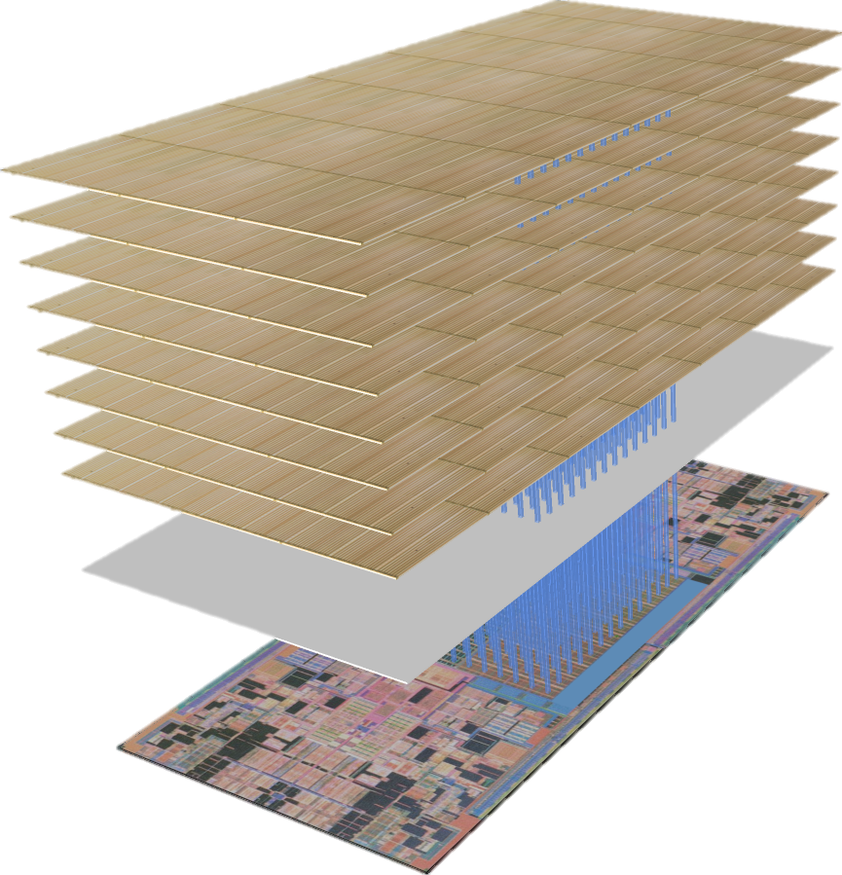
SMART-3D System Architecture
Face-to-Back
N layers
of DRAM
Face-to-Face
Memory
controller
layer
One subbank of MSHR and write-back buffer
Processor layer
One L2 subbank

Slide 16
DRAM Design Issues in SMART-3D
256Mb array
256Mb DRAM array
per tile
2KB row buffer
256 TSVs
256 TSVs
per tile
128 array (= one bank)
lookup per row buffer miss

Slide 17
DRAM Design Issues in SMART-3D
256Mb DRAM array
per tile
256 TSVs
per tile
32k Shared TSVs
Two array (= one bank)
lookup per row buffer miss

Slide 18
DRAM Design Issues in SMART-3D
256Mb DRAM array
per tile
256 TSVs
per tile
32k Shared TSVs
Folded DRAM layers

Slide 19
Simulation Framework
SESC simulator + Modified Cacti
42 applications from SPEC2006int, SPEC2006fp, Olden, NU-MineBench
3GHz, 4-wide, 14-stage OoO processor
IL1
2-way, 64B line, 32KB, 1-cycle latency
DL1
2-way, 64B line, 32KB, 2-cycle latency

Slide 20
Experimental Configurations
2D-Base
L2$: 8-way, 64B line, 1MB, 6-cycle
DRAM: 8B-wide, 12.8 GBps bus, 350-cycle
2D-GHB
2D-VLS
3D-Base
3D-GHB
SMART-3D
2D-Base + Global History Buffer prefetcher
2D-Base + Virtual Line Scheme w/o software control
Same L2$ as 2D-Base
3D-Base + GHB
L2$: 8-way, (4KB line), 1MB, 7-cycle
DRAM: 4KB-wide, 250-cycle
DRAM: 64B-wide, 250-cycle

Slide 21
Single Core Results
1.40x
0.82x
1.25x
1.69x
2.14x
2.83x
Bad spatial locality

Slide 22
Dual-Core Results
1.96x
2.31x
2.40x
3.12x
Baseline: 2D-Base (2MB)

Slide 23
Energy Trade-Off
+ L2 read / write energy
+ L2 fill / WB energy
+ Bus fill / WB energy
- DRAM lookup energy

Slide 24
Why do we save energy in DRAM?
0x0000 0000
0x0000 0040
Conventional
3D DRAM
0x1000 0000
0x1000 0040
0x0000 0080
0x0000 00c0
Row Buffer
Hit rate ~ 50%
Capacity << L2$
One cache line

Slide 25
Why do we save energy in DRAM?
0x0000 0000
0x0000 0040
DRAM
for
SMART-3D
0x1000 0000
0x1000 0040
0x0000 0080
0x0000 00c0
L2 Hits
One cache line

Slide 26
Energy Result

Slide 27
Energy Result
4.79
On average, 47%

Slide 28
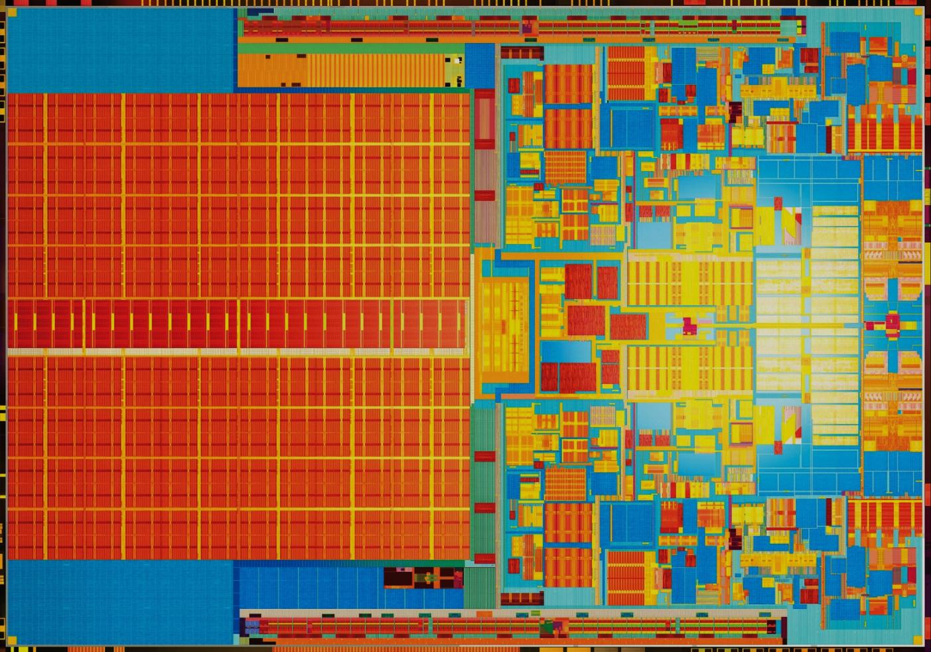
Conclusion

Slide 29
Conclusion
Page fetching through HD-TSVs
3D cache fill / write-back network
Energy-efficient 3D DRAM design
More than 2x speedup
Simultaneously saving energy

Slide 30
Questions?
Georgia Tech
MARS
http://arch.ece.gatech.edu

Slide 31
False Sharing
Same in the L1 bus (64B)
May have an issue in multi-socket platforms
Core 0
Core 1
Core 2
Core 3
Core 4
Core 5
Core 6
Core 7
On-chip Interconnection
On-chip Interconnection
L2 Cache
Bank 0
L2 Cache
Bank 1
L2 Cache
Bank 0
L2 Cache
Bank 1
Off-chip
Interconnection
Memory
Controller 0
Memory
Controller 1
Memory
Controller 2
Memory
Controller 3
DRAM
DRAM
DRAM
DRAM
DRAM
DRAM
DRAM
DRAM

Slide 32
Adaptive SMART-3D
Similar to Sector Cache
Fetch 64B if
The target page is mapped to the remote memory space.
Any of the target page is cached in the remote L2$
Page-level Bloom filter similar to RegionScout or Page Sharing Table
Details of miss handling is in the paper.

Slide 33
Multi-Core

Slide 34
Multi-Socket

