Slide 1
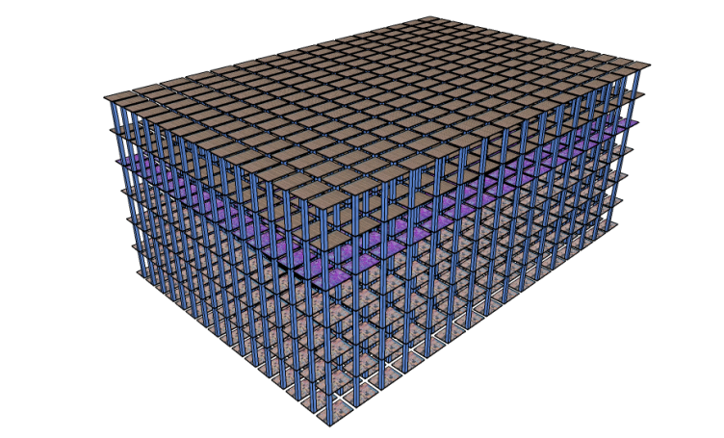
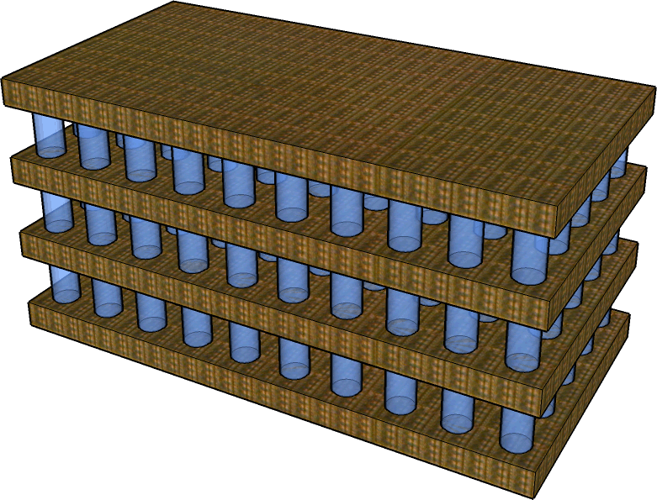
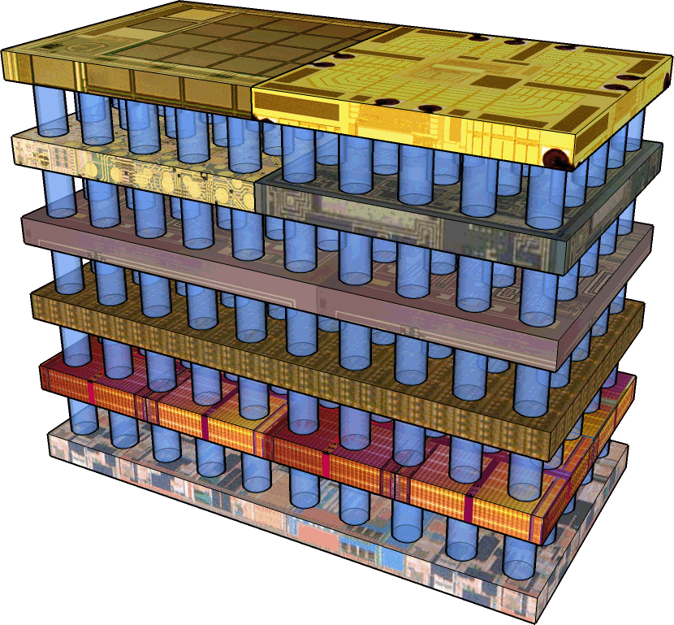
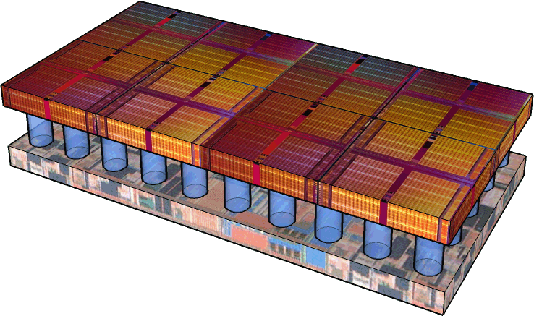
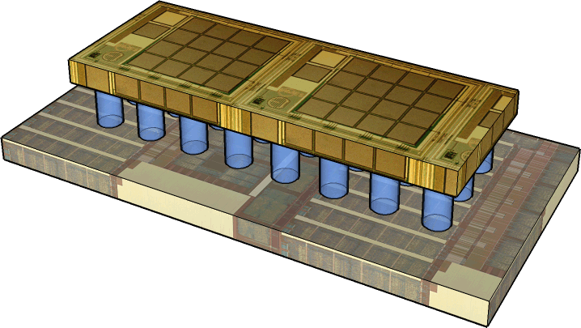
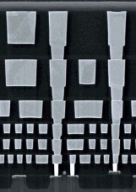
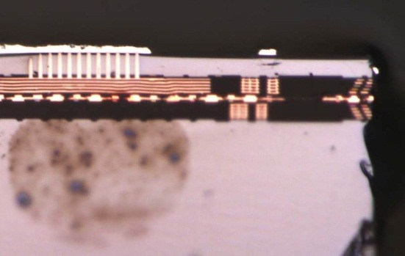
Heterogeneous Die Stacking of SRAM Row Cache and 3-D DRAM: An Empirical Design Evaluation
Dong Hyuk Woo∗
Nak Hee Seong
Hsien-Hsin S. Lee
Electrical and Computer Engineering
Georgia Tech
Intel Labs∗
The 54th IEEE International Midwest Symposium on Circuits and Systems

Slide 2
Modern DRAM Design Challenges
Scaling challenge
Less capacity
Higher leakage
Increasing manufacturing cost
Energy efficiency pressure
Smart phone / tablet
Cloud / Exa-scale computing

Slide 3
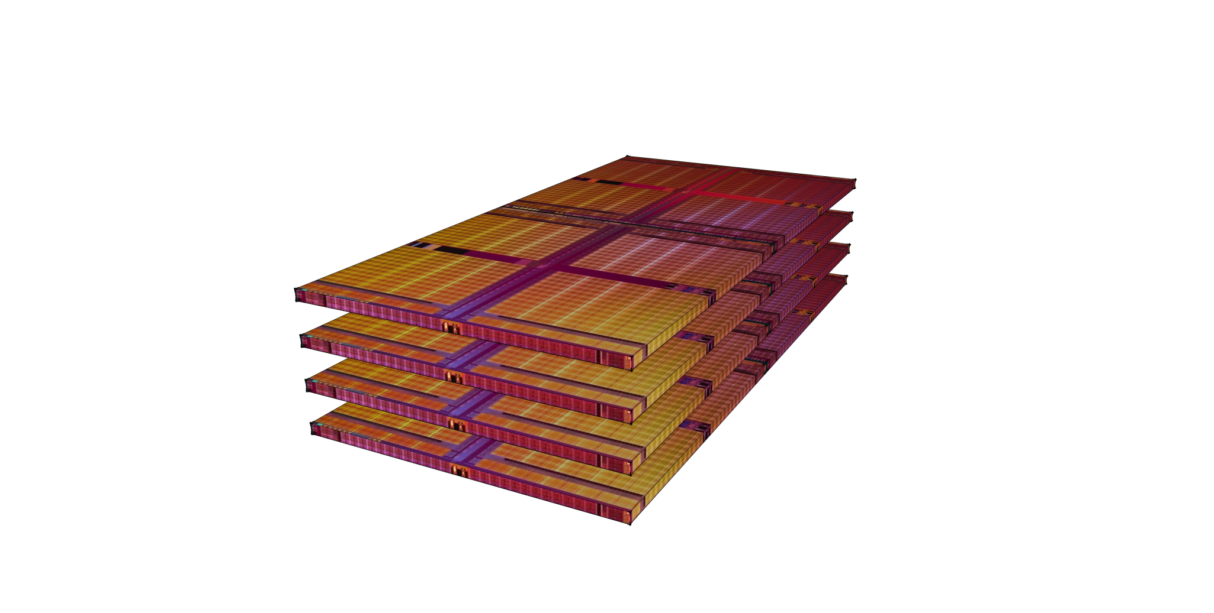
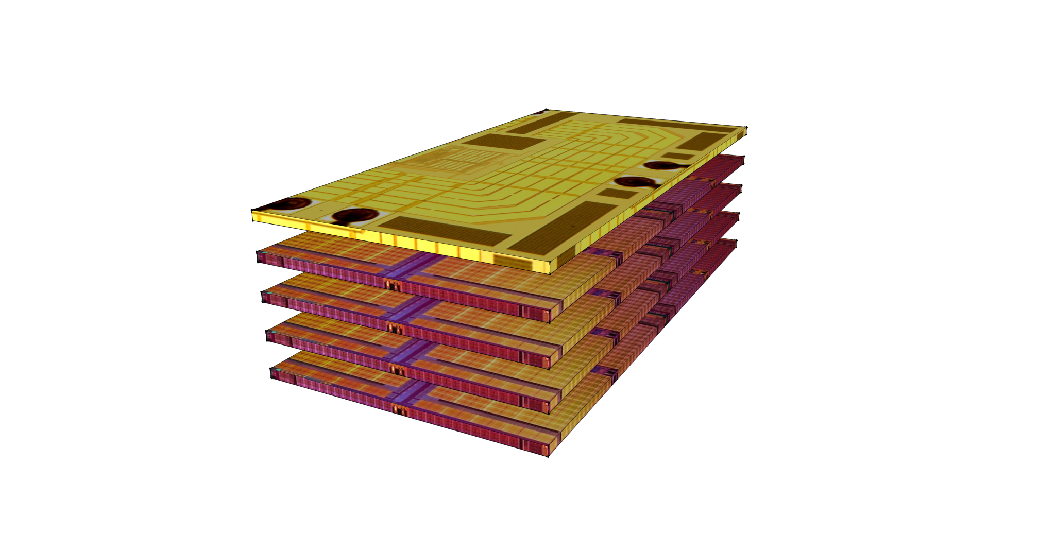
Future Solutions
Heterogeneous stacking [Kawano et al., IEDM 2006]
Dedicating a logic layer for I/O circuit
Better performance, lower energy consumption
Homogeneous stacking [Kang et al., JSSC 2010]
Increasing density without scaling the device

Slide 4
New Opportunity for Processor Architects
SPACE
AVAILABLE
(404) 894-9483

Slide 5
SRAM Row Cache?

Slide 6
An Optimized 3D-Stacked Memory Architecture by Exploiting Excessive, High-Density TSV Bandwidth by D. H. Woo, N. H. Seong, D. L. Lewis and H.-H. S. Lee in IEEE International Symposium on High-Performance Computer Architecture (HPCA-16), 2010.
Motivation

Slide 7
Row Buffer Conflicts in a Multi-core
Address Stream
0x0000 0000
0x0000 0040
Conventional
3D DRAM
0x1000 0000
0x1000 0040
0x0000 0080
0x0000 00c0
Row Buffer
Hit rate ~ 50%
One entry / bank
3 row misses
3 row hits
One cache line

Slide 8
Eliminating Redundant Array Lookup
Address Stream
0x0000 0000
0x0000 0040
Heterogeneous
SRAM row cache
+ 3D DRAM
0x1000 0000
0x1000 0040
0x0000 0080
0x0000 00c0
Row cache Hits
2 row misses
4 cache hits
One row cache line
Row Cache

Slide 9
SRAM Row Cache Stacking
Large set-associative SRAM row cache
Eliminating redundant DRAM look-ups
caused by conflict misses in row buffers
High bandwidth, low energy communication through TSVs

Slide 10
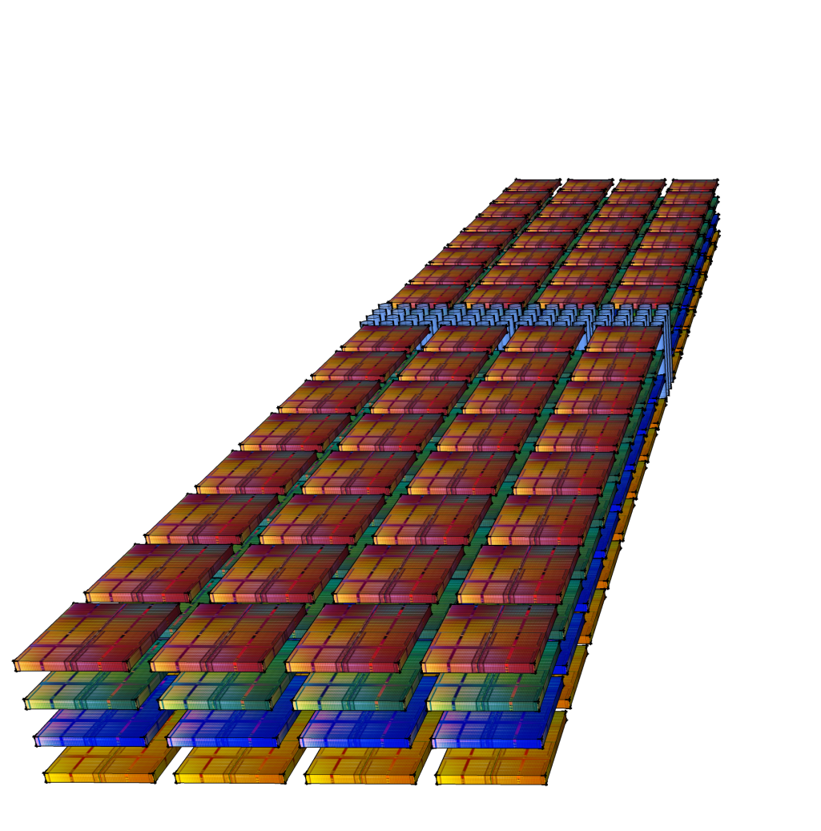
Conventional DRAM Bank Structure
2-D transfer is still energy hungry!
Large area overhead of TSV
TSVs
One bank per die
Not drawn to scale

Slide 11
Folded, Scalable DRAM Bank Structure
Short transfer of large data (a row)
Long transfer of small data (a cache line)
64x64TSVs
64x16TSVs
One half-row = 4Kb (64x64)

Slide 12
Final Design: SRAM Row Cache + 3-D DRAM
One SRAM cache bank per DRAM bank

Slide 13
Performance Results
Performance: Overall Speedup
Performance: Row Hit Rate

Slide 14
Energy Results
Energy: Relative DRAM Lookup Energy

Slide 15
Energy Breakdown

Slide 16
Conclusion
3-D stacking → new light for architects
SRAM row cache for 3-D DRAM
Folded DRAM bank design
Optimize 2-D Traffic
Significant energy savings

Slide 17
That’s All, Folks!
Georgia Tech
ECE MARS Lab
http://arch.ece.gatech.edu

Slide 18
BACKUP FOILS

Slide 19
Simulation Results

